Slide 1
Economic sustainability of a long-term dual agonist GLP1/GIP RA treatment
Surgery or drugs?
Francesco Saverio Papadia, MD, FACS, FEBS (SurgOnc)
Department of Surgical Sciences and Integrated Diagnostics DISC
University of Genoa, Italy

Slide 2
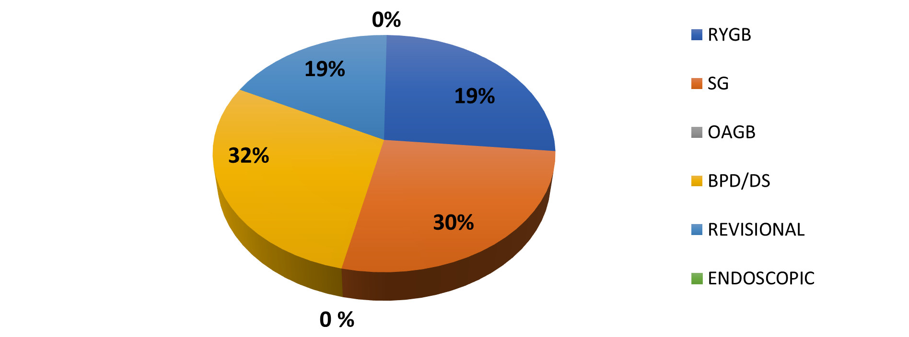
Case mix disclosure
No financial conflict of interest to disclose

Slide 3
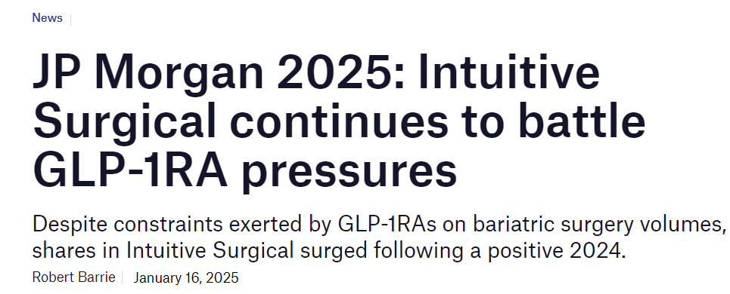
“GLP-1s’ impact on total bariatric surgery was a headwind in the year. We made gains relative to other forms of surgery, but weight loss surgery as a whole has been de-prioritised,”
The number of bariatric procedures... has been declining in recent years....
Multiple studies of privately insured patients have found a significant increase in patients being prescribed GLP-1RAs while those undergoing bariatric surgery have decreased.

Slide 4

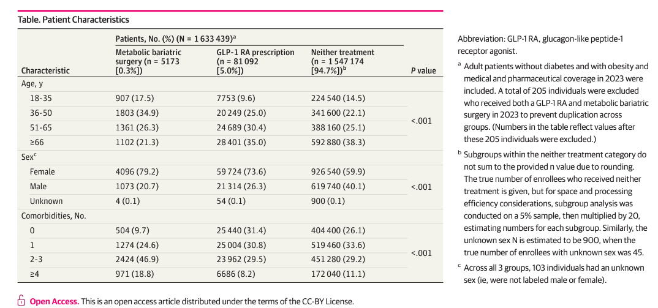

Slide 5
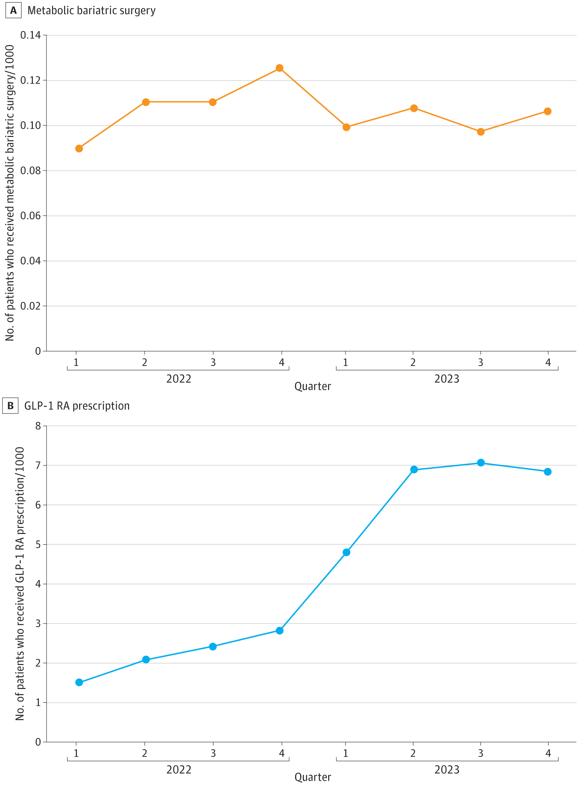

Slide 6
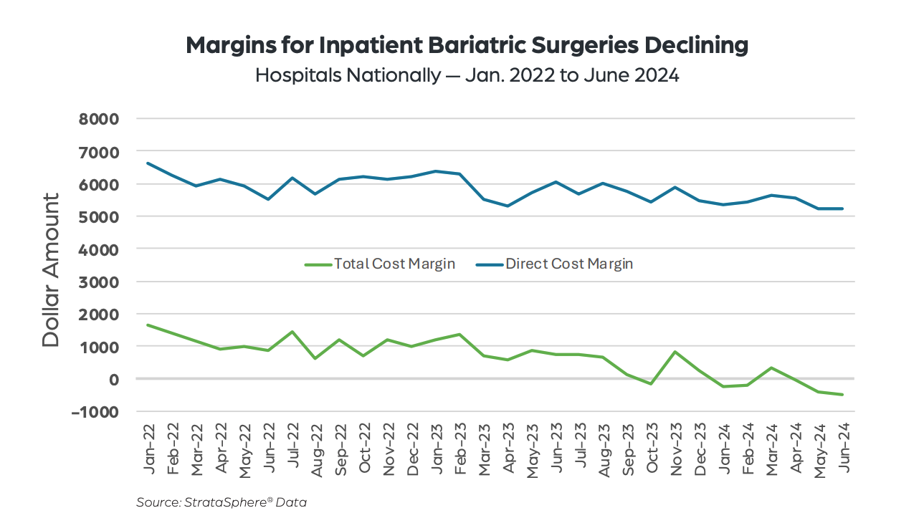

Slide 7
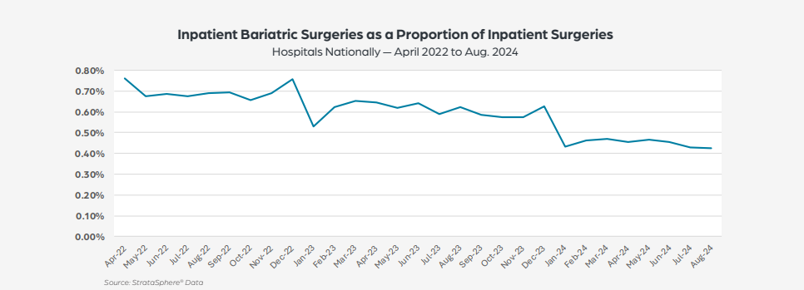

Slide 8
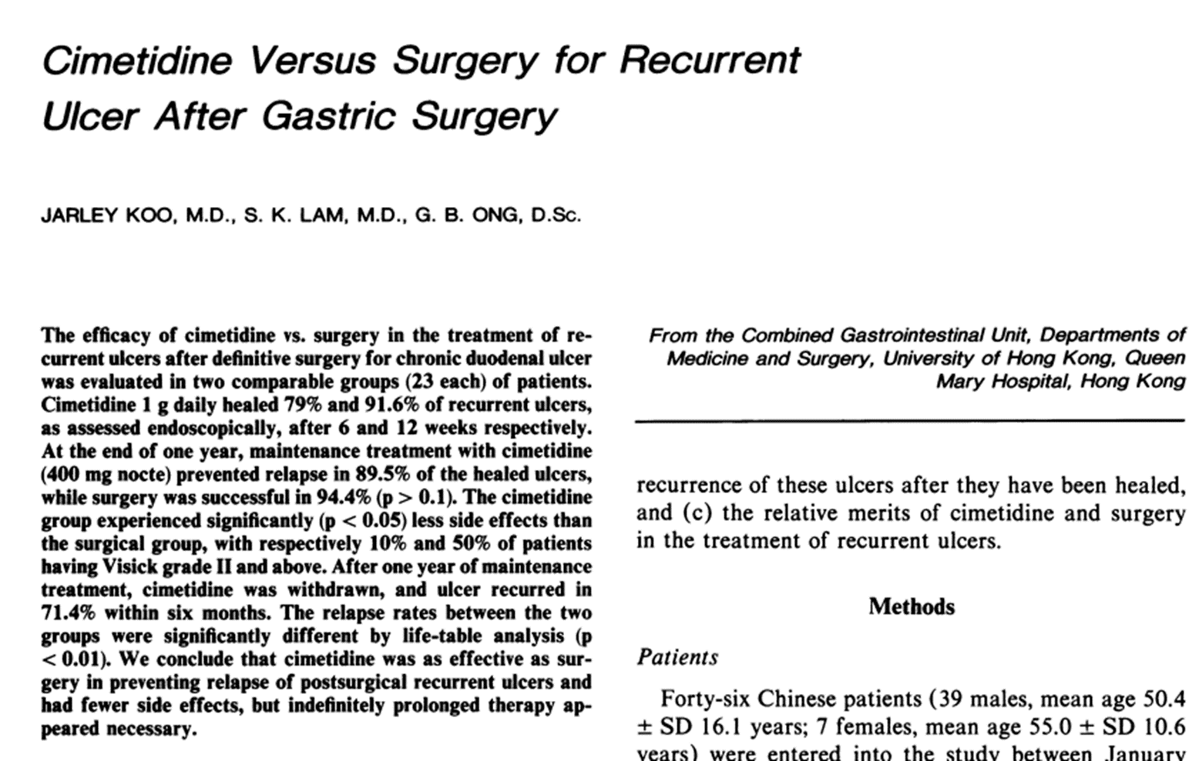

Slide 9
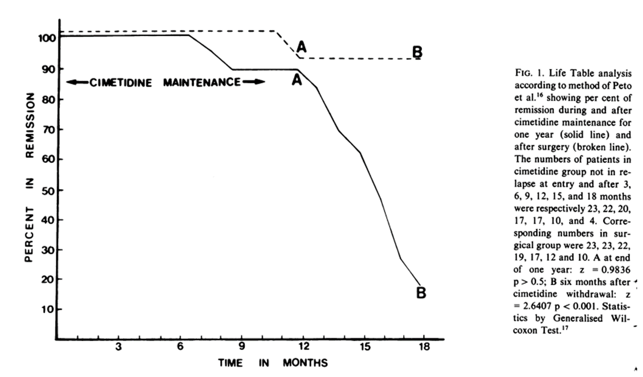

Slide 10

GLP-1 RA
Bariatric surgery

Slide 12
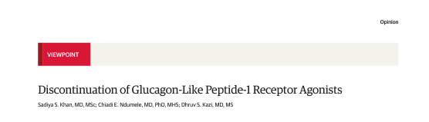
Even though GLP-1 RAs—paired with lifestyle changes such as a healthy diet and increased physical activity—are intended for long-term management of the chronic conditions of obesity and diabetes, many individuals who initiate GLP-1RAs discontinue therapy
Nearly 30% of individuals discontinued semaglutide in the SELECT trial, with real-world estimates for GLP-1 RA discontinuation in the range of 50% to 75% at 12months
While treatment with GLP-1 RAs leads to many health benefits, trials of discontinuation demonstrated rapid regain of weight and worsening of cardiometabolic parameters after stopping semaglutide or tirzepatide--> there may be no return for the investment!

Slide 13


Slide 14
Game theory- the "One-dollar auction"
Because lost weight is commonly regained after the drug is discontinued, the major initial investment for therapy may be unwarranted if most patients eventually stop taking the drug and simply regain weight--> once started, treatment must be continued
Access to GLP-1 agents remains inequitable by race and ethnicity, income

Slide 15
Comparison with different high-cost treatments: direct-acting antiviral medications
The introduction of direct-acting antiviral (DAA) medications revolutionized hepatitis C treatment, offering high cure rates with shorter therapy durations.
However, these advancements came with substantial initial costs.
Initial Pricing:
Sovaldi (Sofosbuvir): Approved in 2013, Sovaldi was priced at approximately $84,000 for a standard 12-week course, equating to $1,000 per pill.
Harvoni (Sofosbuvir/Ledipasvir): Introduced in 2014, Harvoni's 12-week regimen was priced around $94,500.

Slide 16
Price Evolution:
Over time, several factors contributed to a decline in the prices of these medications:
Market Competition: The approval of additional DAAs increased competition, exerting downward pressure on prices.
Negotiated Discounts: Pharmacy benefit managers and government programs secured significant discounts. By 2015, average discounts for Sovaldi reached approximately 46%, reducing the treatment cost to about $40,000.
Generic Versions: In various countries, the introduction of generic DAAs further reduced prices, enhancing accessibility.
Global Perspective:
In low- and middle-income countries, licensing agreements and generic manufacturing have led to even more significant price reductions. For instance, in India, the cost of a generic version of sofosbuvir has been reported as low as $4 per pill.
But: hepatis C does not relapse after drug withdrawal, obesity does!
Production of peptides is inherently expensive (not so small molecules.....)

Slide 17
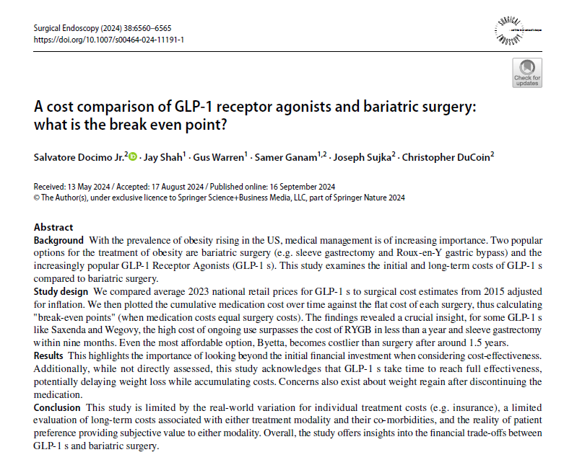

Slide 18
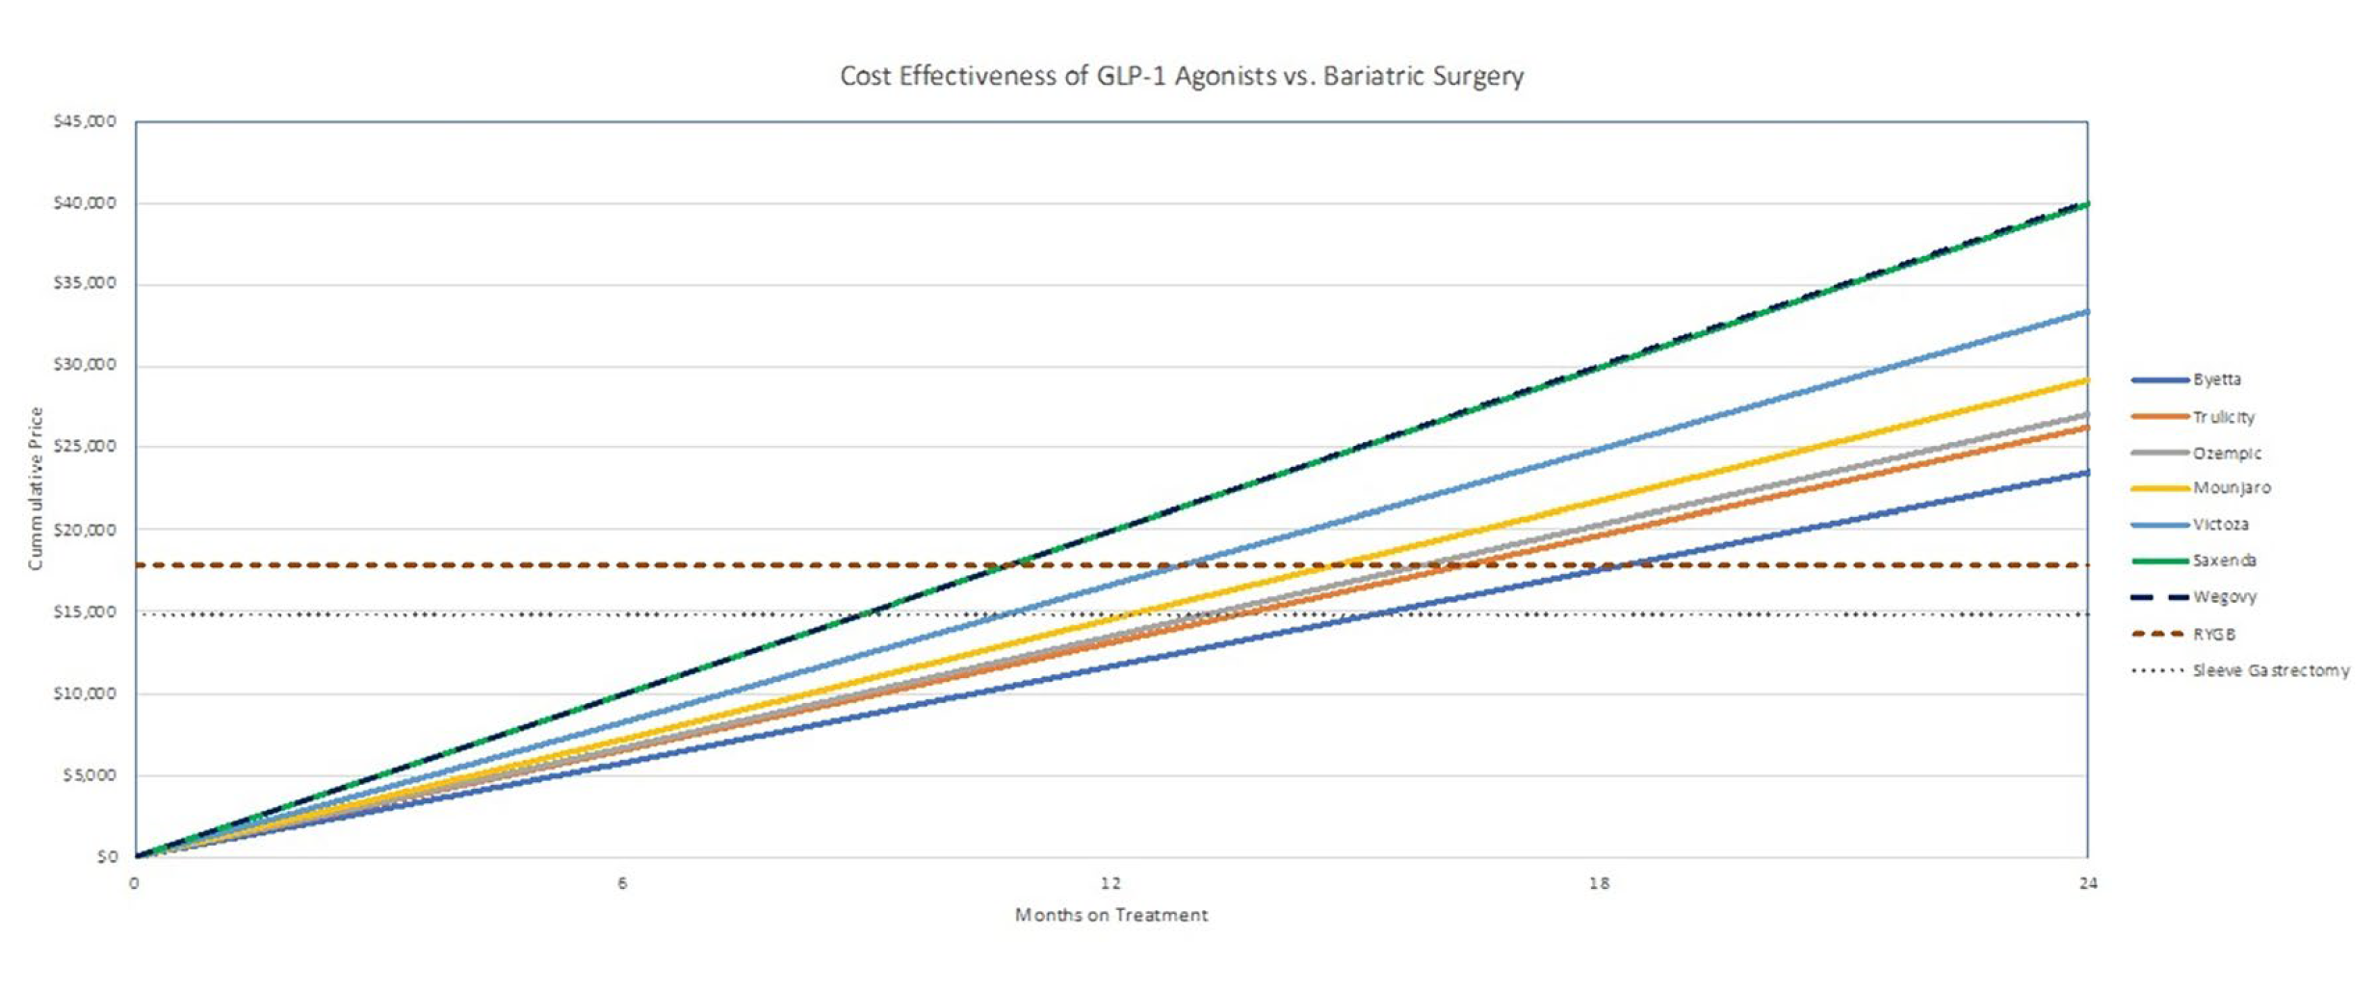

Slide 19
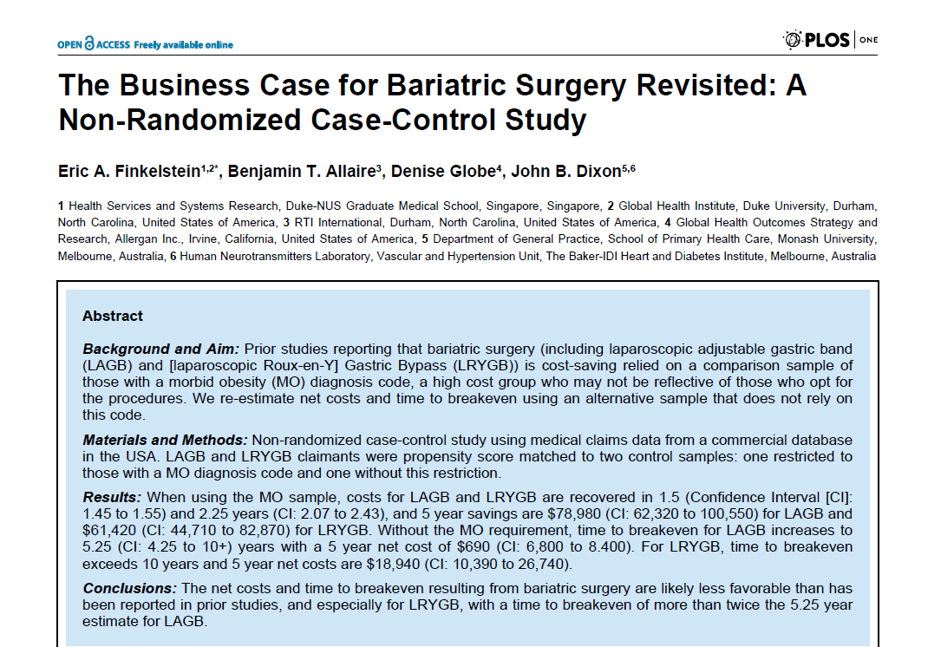

Slide 20
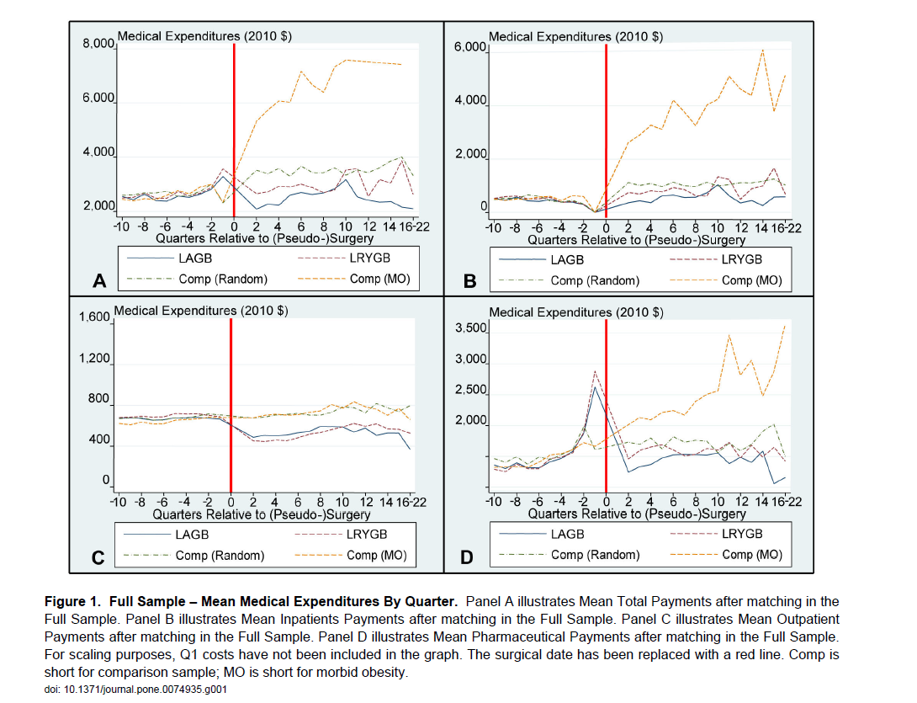

Slide 21
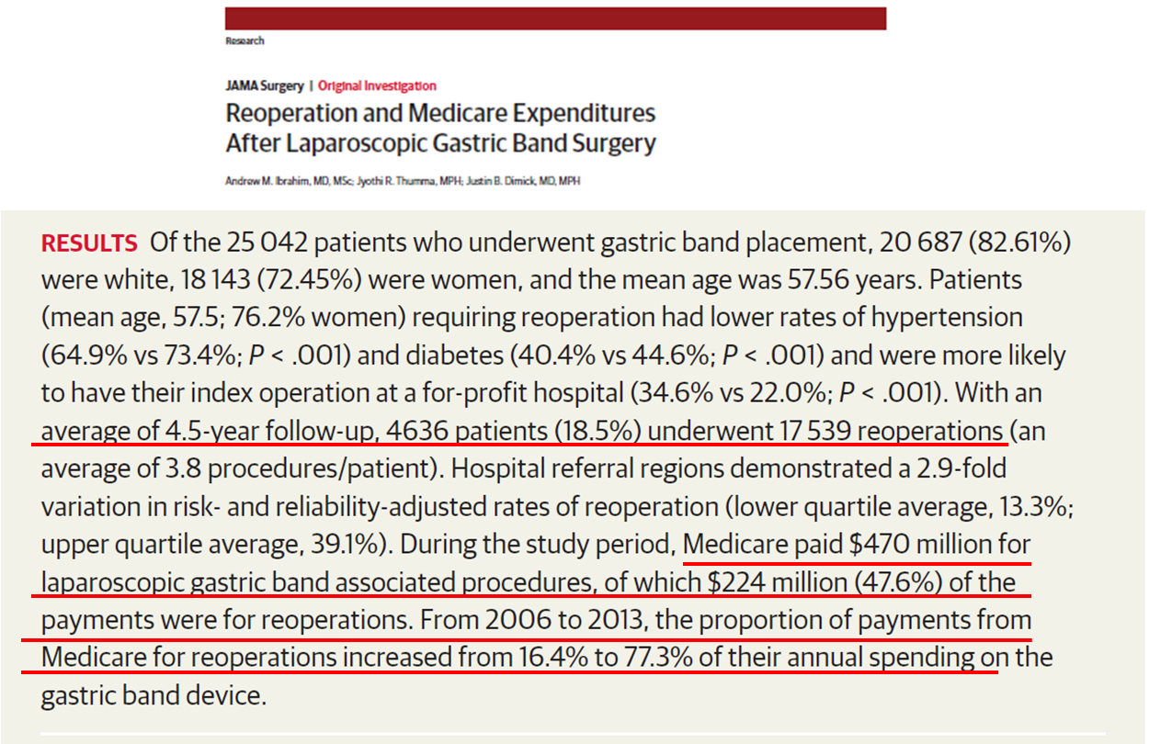

Slide 22
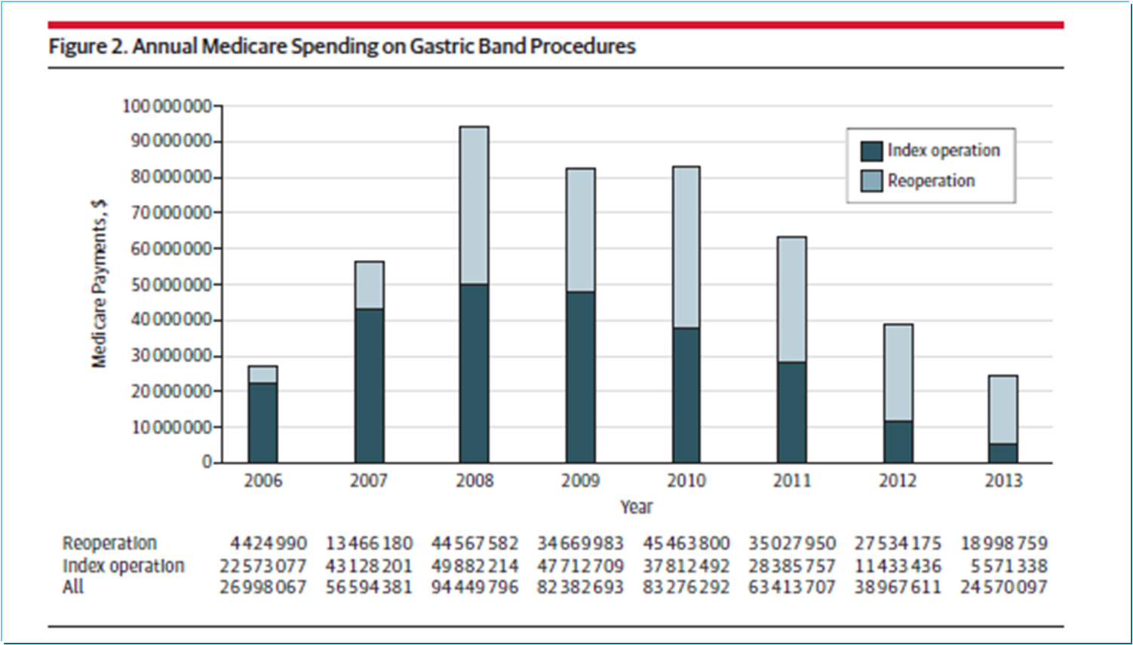

Slide 23
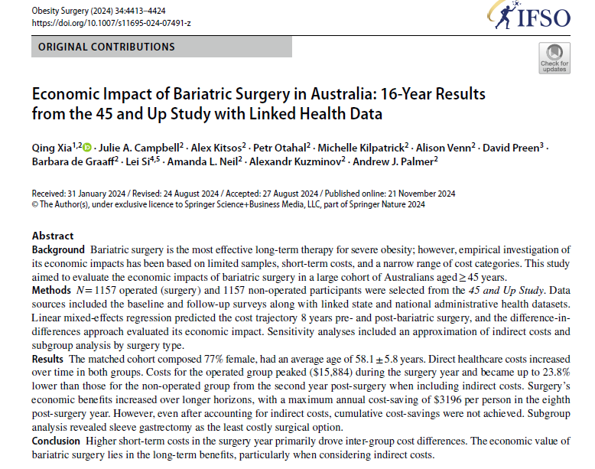

Slide 24
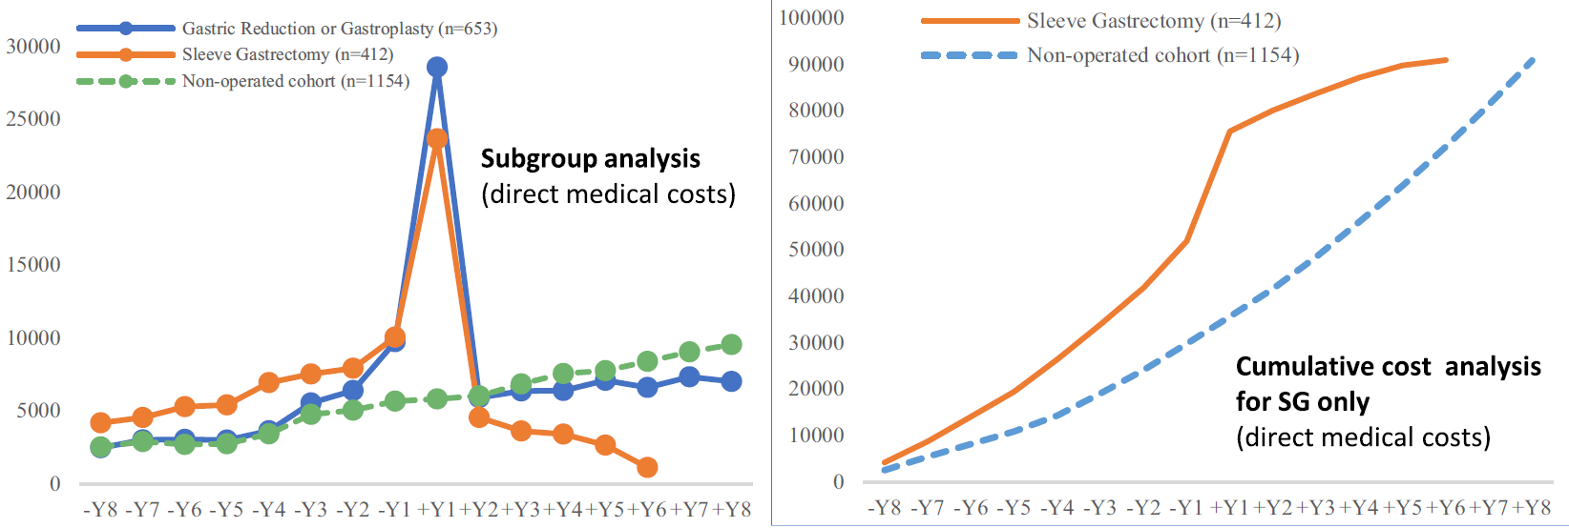

Slide 25
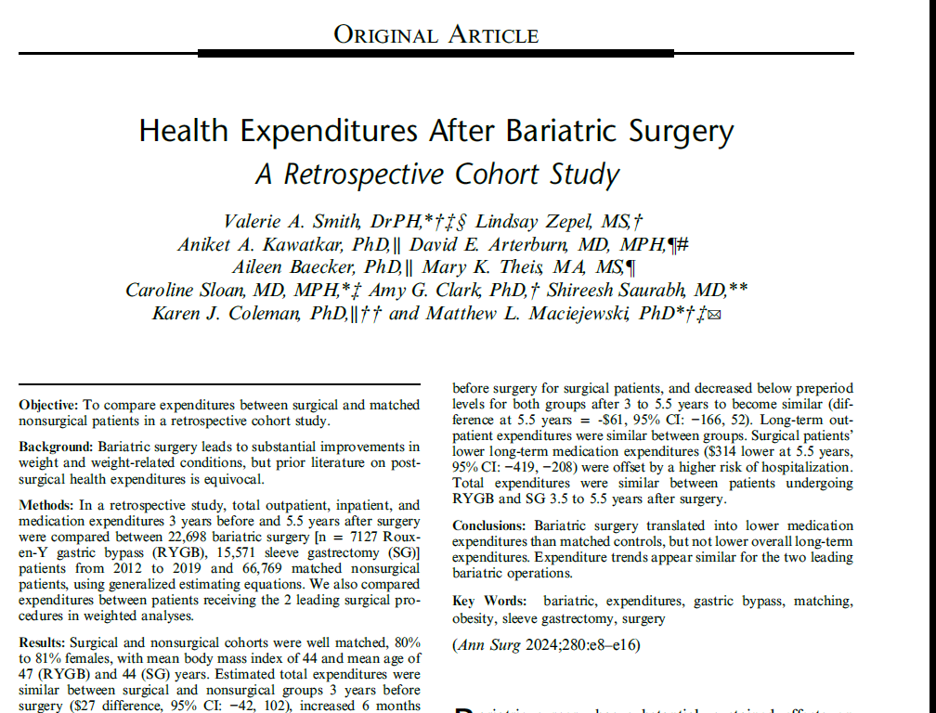

Slide 26
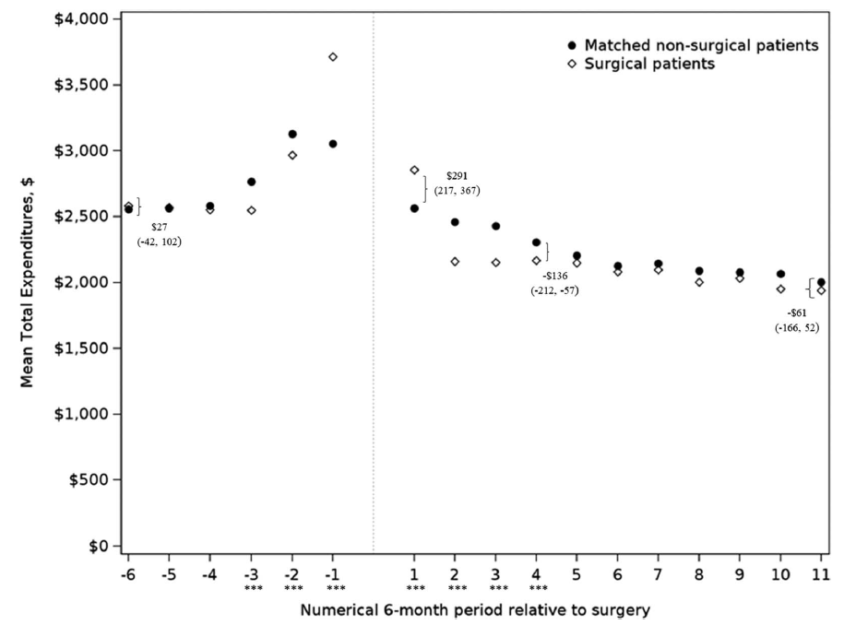

Slide 27
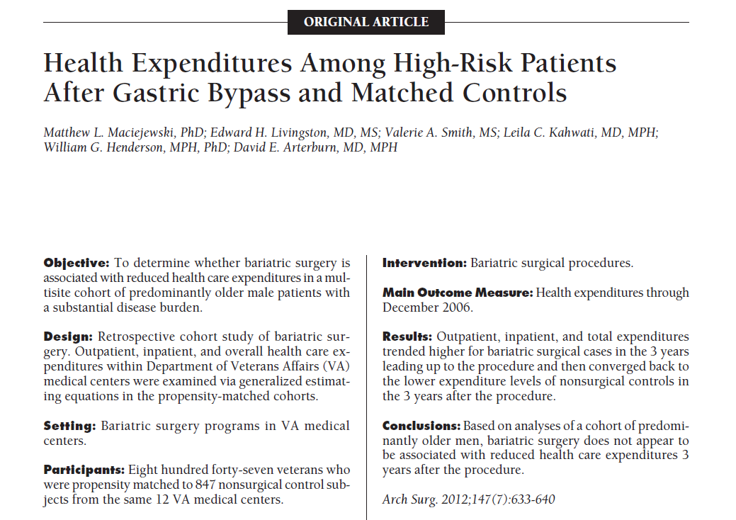

Slide 28
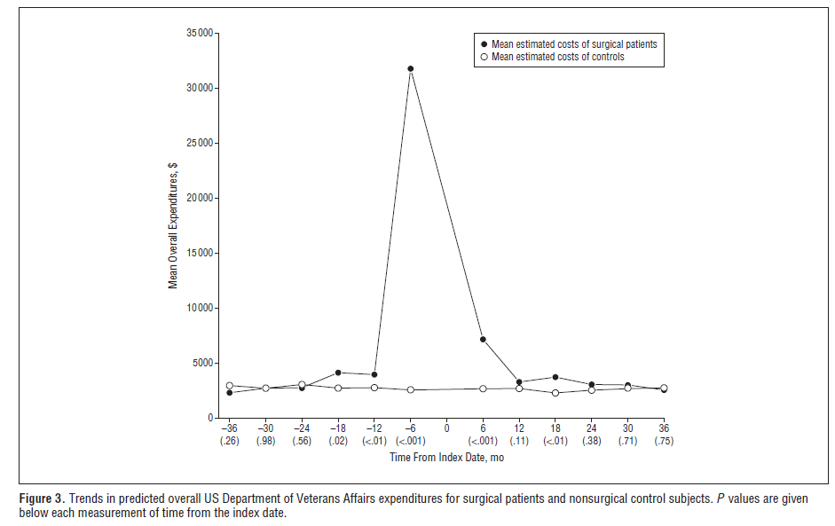

Slide 29
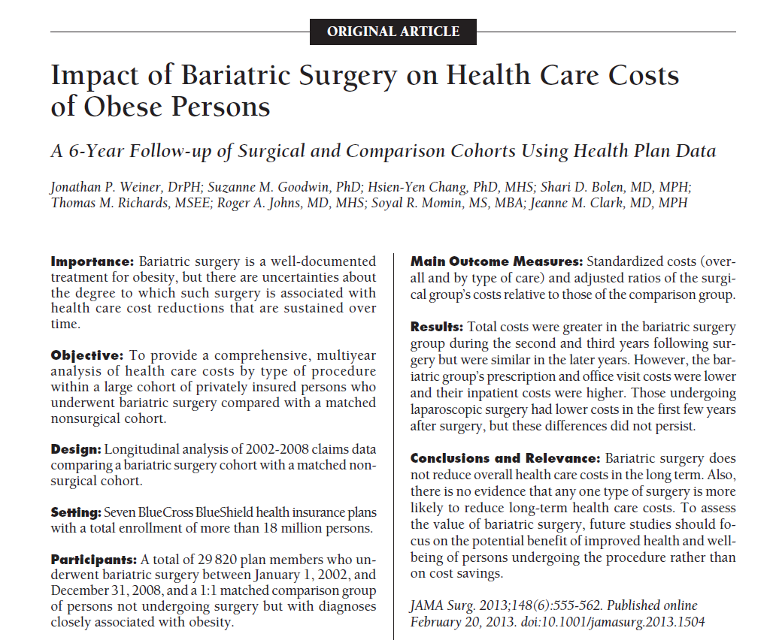

Slide 30
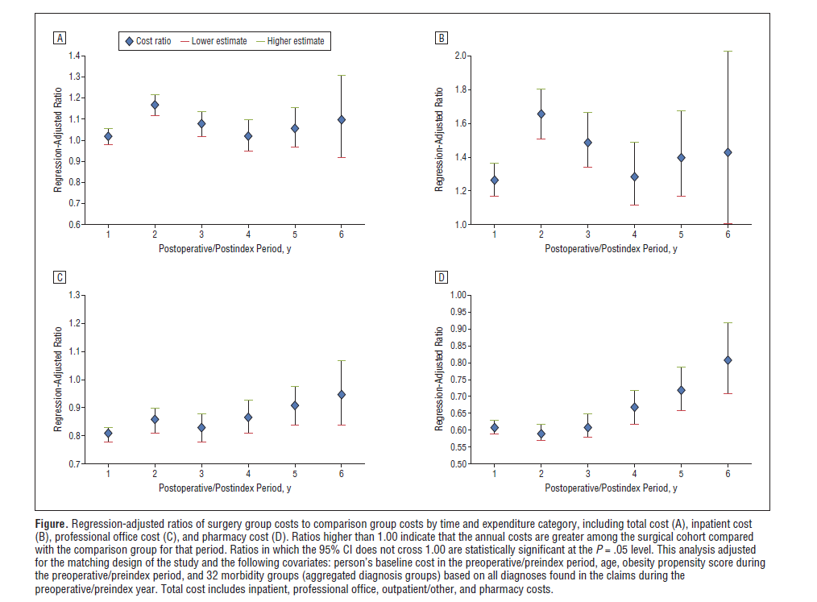

Slide 31
Conclusions
With the current prevalence of obesity, and the current prices of GLP1 RA, long-term drug treatment is unsustainable
Drug withdrawal is associated with weight regain--> "one-dollar-auction paradox" for the pharma treatment
Comparison with different high-cost treatments is misleading
Contrary to popular belief, there is no proof that bariatric surgery is associated with long-term savings (at least up to 8-10 years)
Small molecules instead of peptides might alter the scenario

Slide 32
Thank you for your attention!
Francesco.papadia@unige.it

